Slide 1
New Director Training
Virtual Format

Slide 2
MODULE TWO
For
Compliance to
WIOA
Monitoring

Slide 3
Multiple Types: Monthly Quarterly, EOY, Site Visits
Monitoring
For Compliance

Slide 4
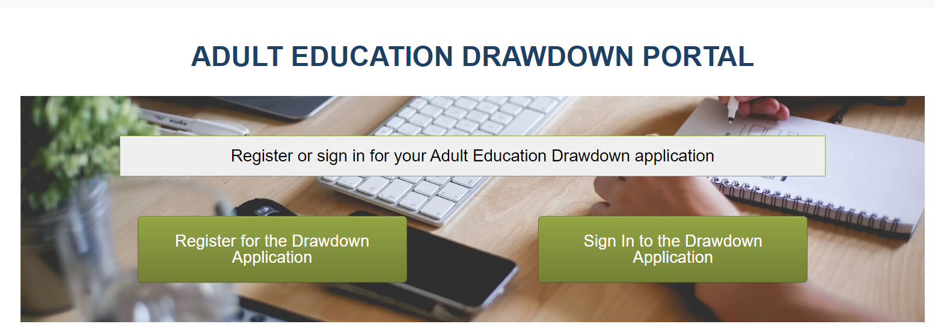
Monthly Drawdowns
Fiscal Compliance
Budgets established once award letters are sent out
Drawdown of previous month expenditures are due by the 5th of each month
Are done through the WCCC website portal

Slide 5
Monthly Monitoring
Desk Monitoring Tool
3 parts: Data Review, Fiscal Review, General Comments
Due by the 10th of each month on the previous month
Template and instructions on how to complete & submit are available at: https://communitycolleges.wy.edu/adult-education/directors/
Notes:
Statistical data is obtained from the LACES database and must include all up-to-date data for the previous month.

Slide 6
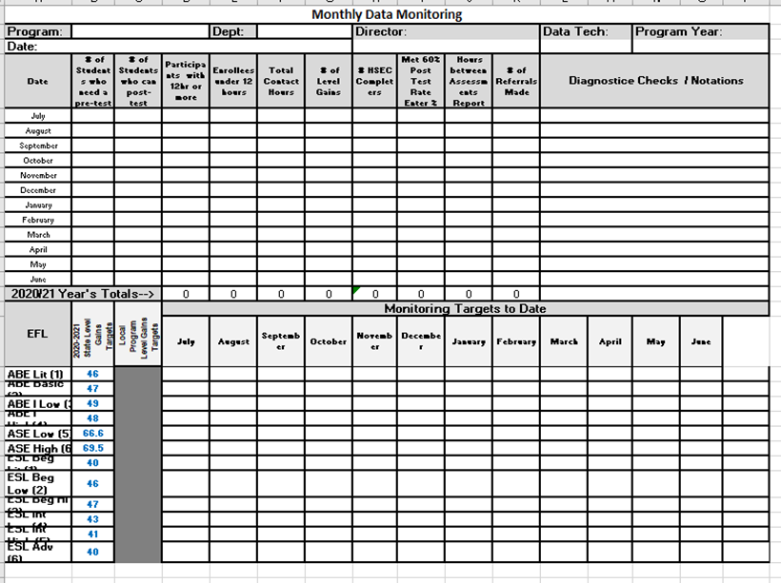
Monthly Desk Monitoring Tool
Page One: Data
A Statistic Monitoring Review of program performance for each month

Slide 7
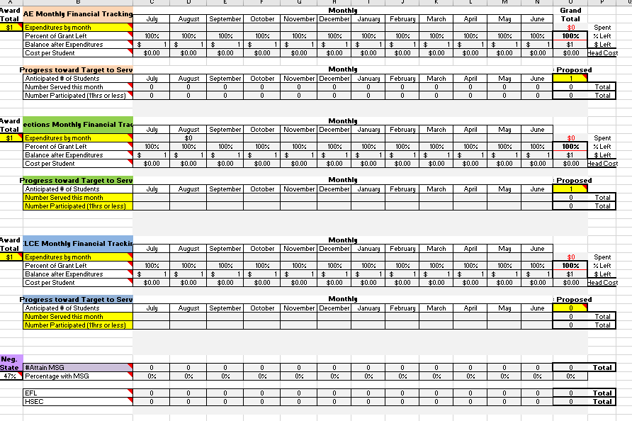
Monthly Desk Monitoring Tool
Page Two: A Fiscal Review
Yellow: Complete at beginning of year
Living document-gets added to each month
3 grant types
Copy drawdown submissions each month into appropriate line item

Slide 8
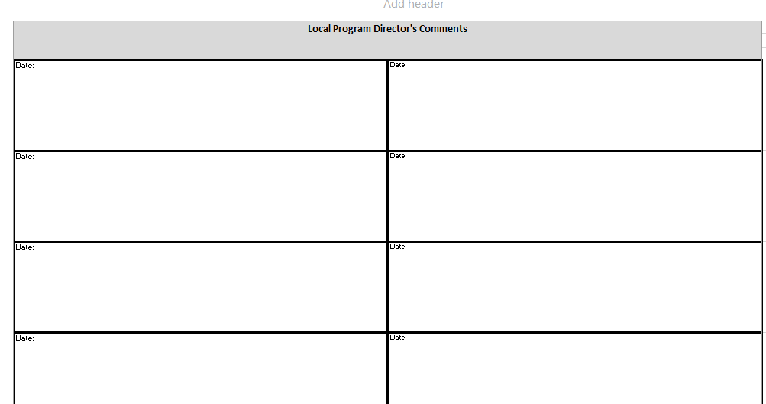
Monthly Desk Monitoring Tool
Page Three: General
Director’s comments on events, challenges, etc. that occurred during the month

Slide 9
LACES Reports to be run/reviewed monthly
Hours between Assessments
Referrals
Diagnostic Reports
All Tables
Review of Dashboard for Accuracy
Surveys Needed
Referrals Made

Slide 10
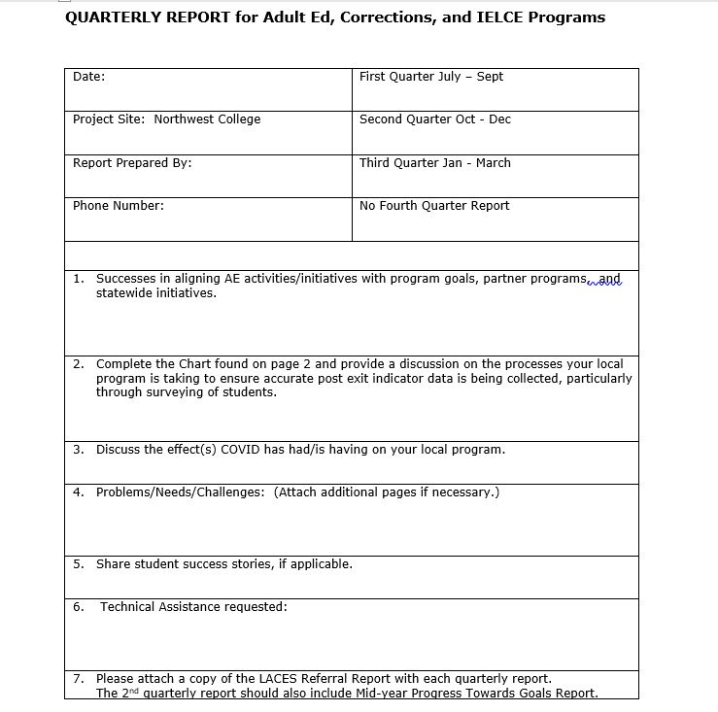
Quarterly Monitoring
Quarterly Report
7 questions
Successes
Surveying of students
Effects of COVID
Problems/Needs/Challenges
Student success stories
Technical Assistance
Referrals
Template available here.

Slide 11
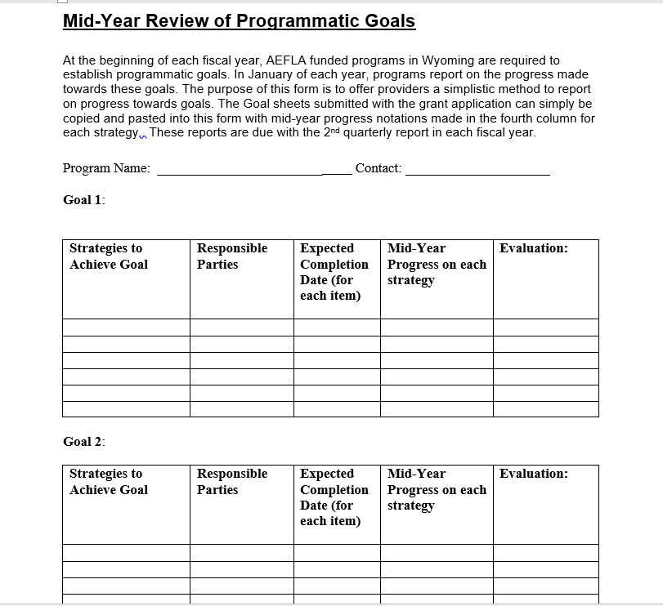
Goals
Progress towards Goal
Due with 2nd quarter report
Reviews progress being made towards the four goals outlined in (re)application
Template available here.

Slide 12
EOY Reports
Narrative
Tables
Teacher Information
Additional Forms & Reports
Notes:
There are multiple parts to the EOY narrative.
The narrative itself is described in more detail on the following slide.
The tables submitted with an EOY report are compiled from LACES and do not require any local program compilations.
Teacher information: New staff forms, updated LACES data, etc.
Additional forms/reports: cover sheet, data quality checklist, cash & in-kind reports, Fiscal status reports, powerpath summaries.

Slide 13
Effects of COVID
Success/Challenges
Performance: Data Analysis
Integration of AE Activities
Program Evaluation/Monitoring
Use of Standards
ECR
Alignments to State Plan/Statewide Initiatives
Professional Development
Notes:
A typical EOY narrative asks that the local program address each of these items.
The Effects of COVID is a series of questions that will be eliminated once the pandemic stops creating challenges for local programs. These questions ask the provider to consider how the pandemic has affected such things as performance, retention, enrollment, financial, and other aspects.
Successes/challenges: here again this is a series of questions that can change from year to year. On the whole, these questions can include changes to a program, goals, transitioning students from ESL to ABE and or to postsecondary/training, IET’s, IELCE, etc.
Performance data analysis: this section is an in-depth analysis of what program data indicates for the year. Why did students leave before completing? What are some possible reasons/explanations for variations in this year’s data as compared to the previous year? What are the implications of this year’s data upon how the program will conduct its business next year?
Integration of AE activities: here the program is expected to answer such questions as: How well did the program work with local and regional service providers to ensure student success? How did the local program utilize a career pathways system? What types of jobs/training programs were available for students and how did placements occur?
Professional Development describes the program’s efforts to improve teacher/staff quality.
Evaluation and Monitoring looks at the quality of the services provided through the year and how evaluation results were used to improve program performance.
Standards in the classroom: Programs are typically expected to answer questions relating to how educational standards are implemented in the classroom.
Essential Components of Reading: What efforts did the program make to ensure that ECR was a critical component of AE classrooms?
Alignments: This final question provides the opportunity for the AE program to describe successful/non-succesfful alignments to the one-stop system, the unified state plan, and other statewide initiatives.

Slide 14
Data Quality Checklist
Examines: Data Foundation & Structure, Data Collection & Verification, Data Analysis & Reporting, Staff Development,
Has three tiers
Mirrors Federal Report
Certification
Data Quality Improvement Plan
Template available here
Notes:
Is due with EOY report

Slide 15
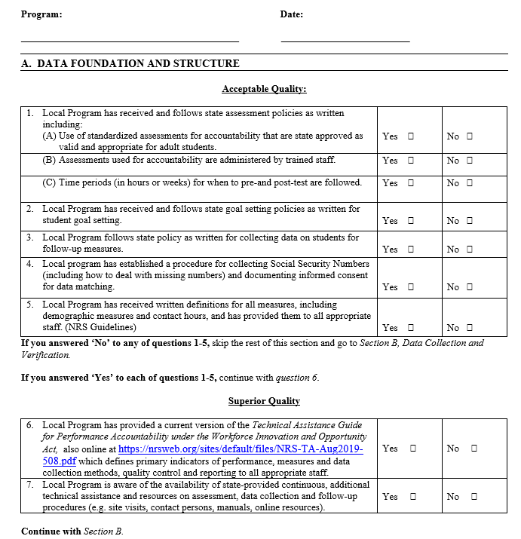
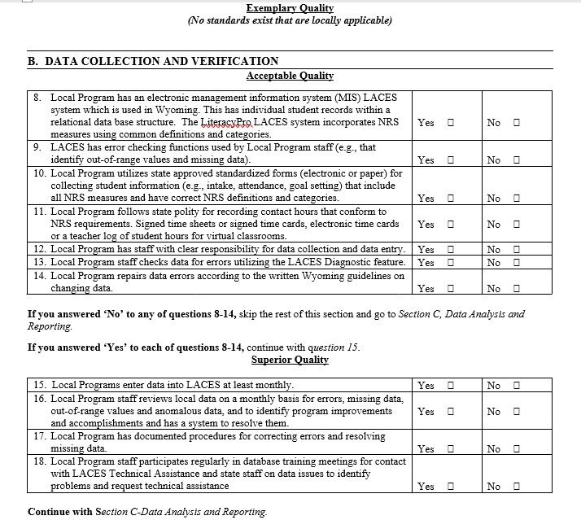

Slide 16
FSR’s
Federal
Federal dollars spent
Program Income
State
State dollars spent
Indirect Costs
Schedule A: Local Cash Match & Non-Federal in-Kind Match (Maintenance of Effort)
Forms and instructions are available on WCCC website
Notes:
The FSR’s also mirror the State’s federal EOY financial reports. These are discussed in more detail in Module 7.

Slide 17
Site Visit: Checklist
Purpose
to ensure that programs are meeting AEFLA requirements as described in the 13 considerations and other federal documents
To improve the quality of federally funded activities
Provide assistance in identifying and resolving accountability problems

Slide 18
Site Visits: Virtual
Checklist
Notes:
Site visits occur every two years. These are a virtual, comprehensive review of a local program and require that the site provide evidence that it is in compliance to State and federal guidelines for grant funded programs. In order to help local providers identify and prepare documents, the State provides a checklist of items that need to be reviewed for compliance.

Slide 19
Virtual Site Visit Monitoring
16 chapters with approximately 5-10 items in each chapter
A student checklist: reviews randomly sampled student files
Evidence & completed checklist is submitted to State on a thumb drive
Checklist mirrors federal monitoring tool
Asks that providers submit evidence to demonstrate compliance to each item
Provides directors with an opportunity to ‘really’ learn and understand their program
Know Your Program
Notes:
Monitoring is a chance for local programs to brag about their program accomplishments AND to provide evidence all of the ‘good things’ you are doing!
It is meant as a means for directors/programs to learn about all of the federal requirements for accountability purposes.

Slide 20
The Monitoring Tool Checklist
Intake / Orientation
Student Eligibility, Marketing & Retention
Sufficient Intensity & Duration
Education/Instruction & Career Counseling
Program Personnel
Staff-Professional Development
GEPA
WIOA System Network
Assessment
Student Files
Cooperative Planning & Partnership
Facilities, Equipment & Supplies
High Quality Data Mgmnt System
Internal Program Evaluation
Fiscal Review
Reports
Notes:
There are 16 chapters to the monitoring tool checklist. The content of each chapter is aligned to reflect current practices, policies, regulations, and items addressed in the RFP.

Slide 21
Student File Audit
Template available here.
Notes:
The Student File Audit: A State identified random selection of student files. This document requires that evidence be submitted for each item shown on the checklist for the five students identified by the State.

Slide 22
The Checklist
Template available here.

Slide 23
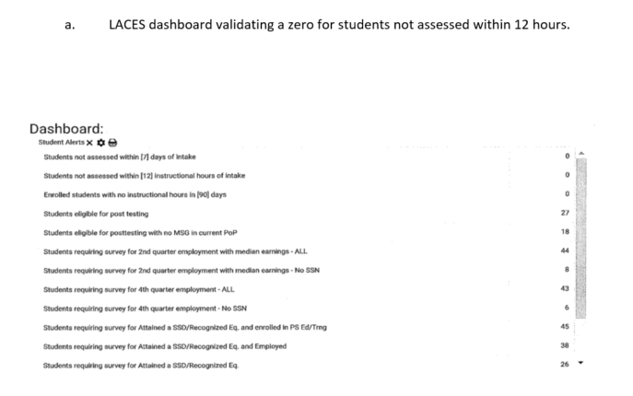
Chapter 1: What evidence?
A valid NRS approved pre-test is given within the first 12 hours of instruction with both ABE and ESL students.

Slide 24
Chapter 2: What evidence?
Age waiver students:
• complete a program of study
• are enrolled in LACES
• complete an OPT at the ‘Well Prepared’ level for HiSET
• have a valid, NRS approved pre-test AND post-test (when
applicable)

Slide 25
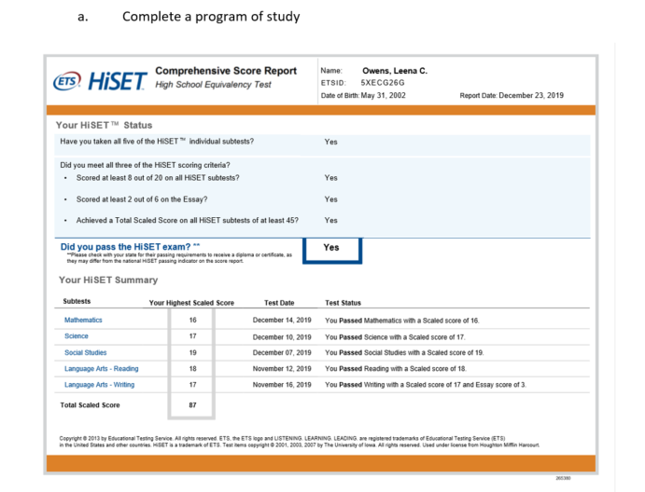
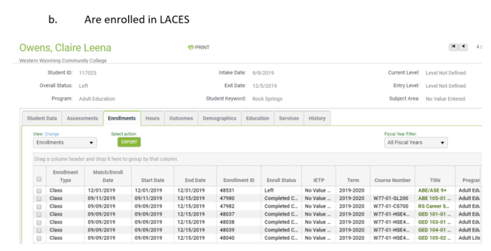
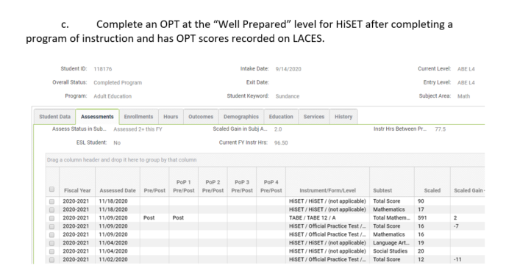
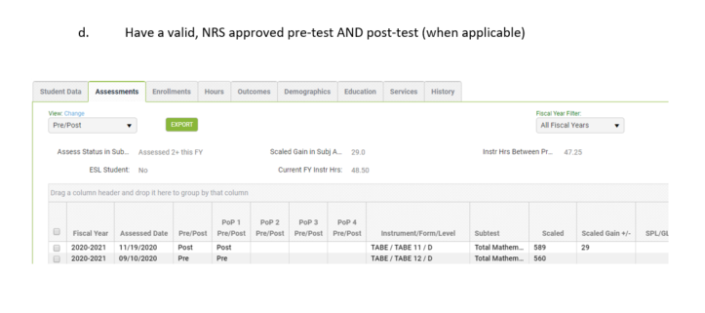

Slide 26
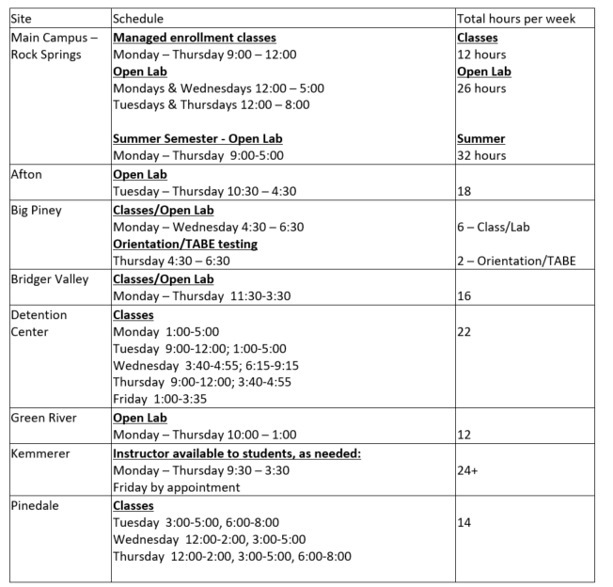
Chapter 3: What evidence?
Program offers at least 6 hours per week at satellite classes and at least 20 hours per week at the main campus of instruction at a minimum.

Slide 27
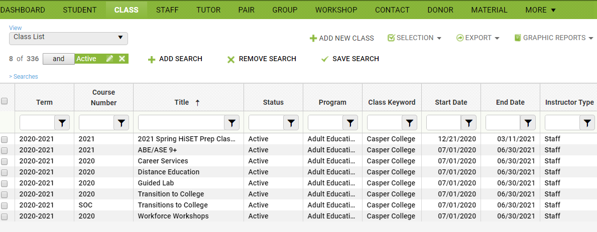
Chapter 4: What evidence?
Program can verify through LACES that they maintain a Career Service Course and an ABE/ASE 9+ course to track students who are pursuing a course of study at a 9th grade level or higher.

Slide 28
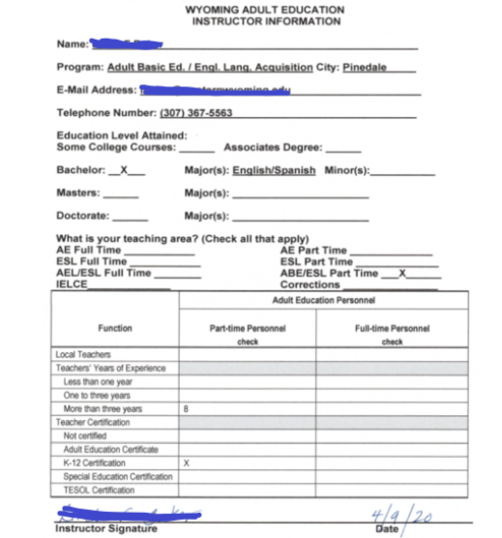
Chapter 5: What evidence?
Program is staffed by qualified instructional staff

Slide 29
Chapter 6: What evidence?
Instructional staff attends a minimum of six hours of staff development annually related to their program in addition to the State Institute.

Slide 30
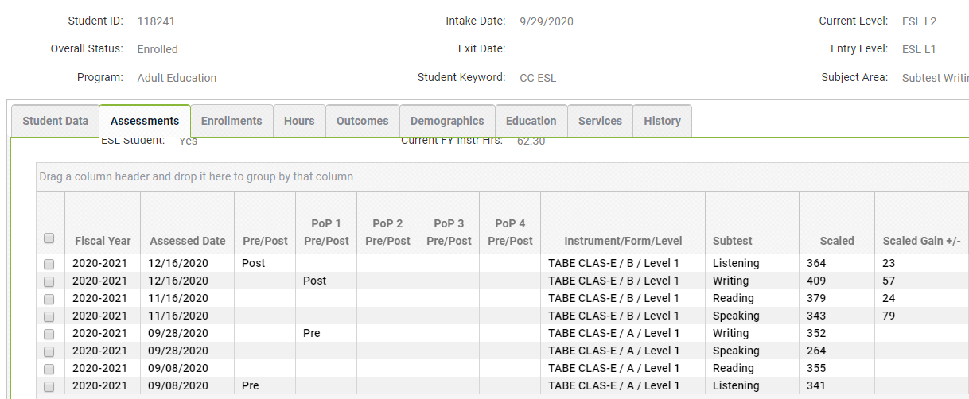
Chapter 7: What evidence?
Pre and post-testing is completed using alternate forms of the test or the required additional hours between testing have been observed.

Slide 31
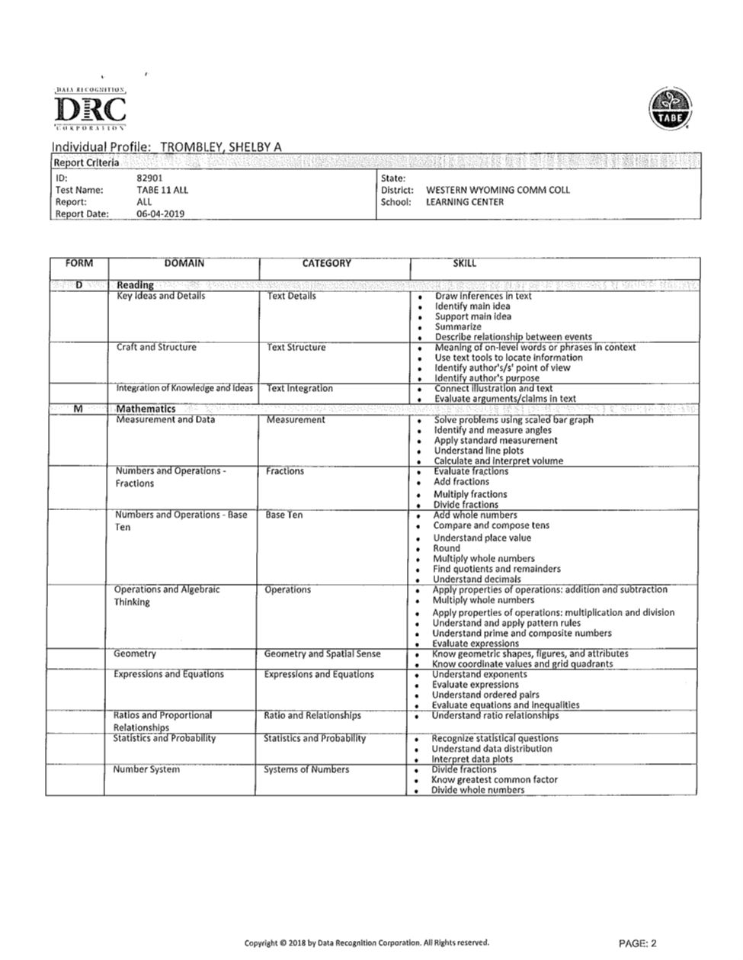
Chapter 8: What evidence?
Computer prescriptive results or student profile is in the file.

Slide 32
Chapter 9: What evidence?
Local program can demonstrate that collaborative efforts have led to a reduction in the duplication of services among core partners, as required by WIOA.
Narrative:
The core partners have offered joint programming in the past such as “Bring Your A Game” and mock interviewing. We are currently scheduling our Friday symposiums that will start in mid-January for any of our clients/students (required of ASPYRE) to attend. Joint instruction will include such topics as “Bring Your A Game” (soft skills course and certification), Work readiness course (dress for success, resumes, mock interviewing, etc), and we are hoping to add discussions about possible job shadowing and pre-apprenticeship opportunities.
DWS and AE have a youth program “ASPYRE” for students between the ages of 16-24 (see flyer below).
DWS has office space in our lab and scheduled days/hours to work with students on-site. DVR will come on-site when there is a student in need of their services.

Slide 33
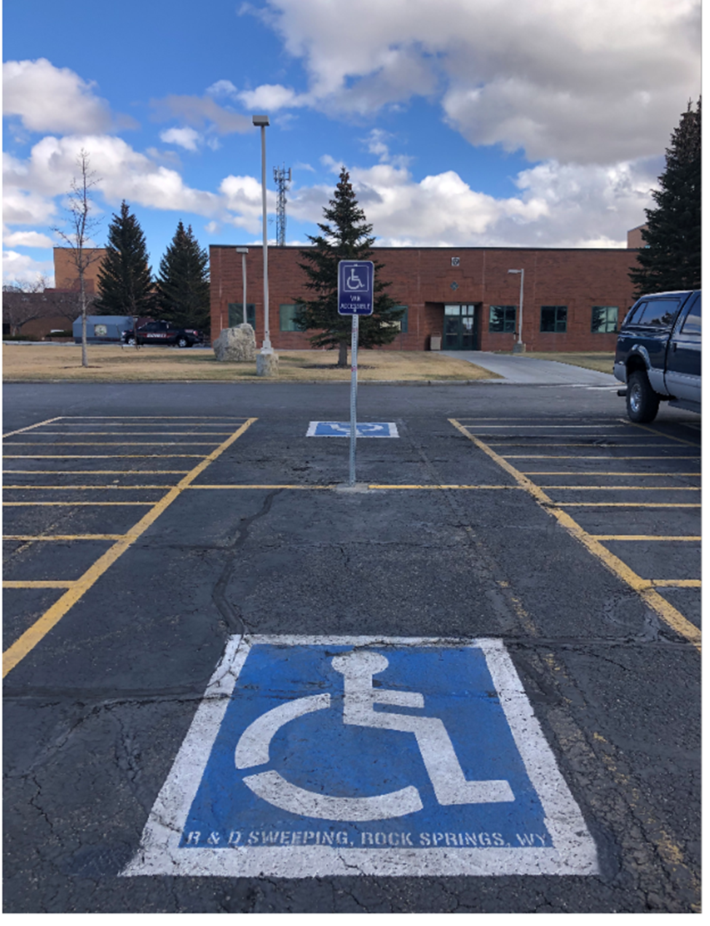
Chapter 10: What evidence?
Handicap accessible parking is available.

Slide 34
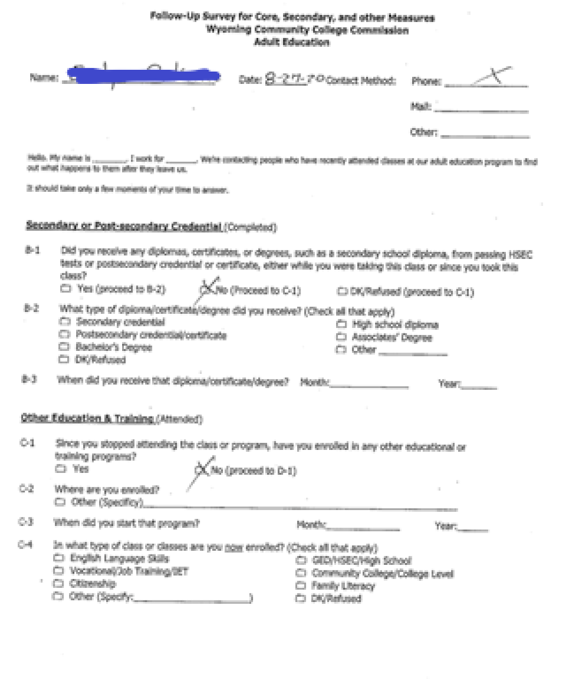
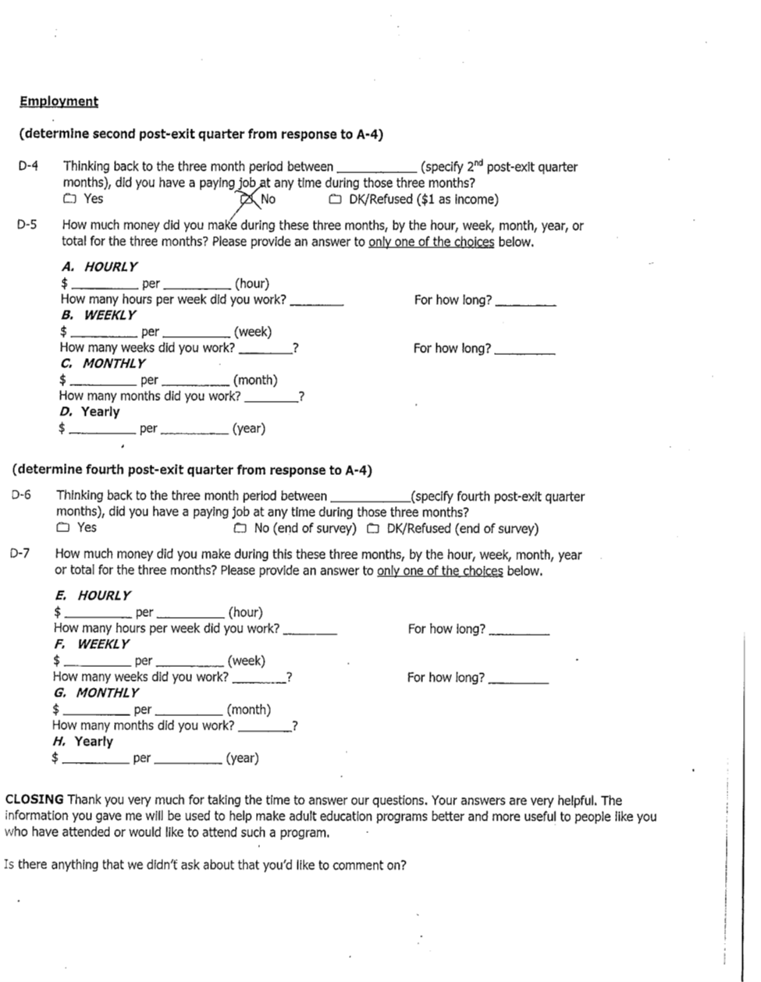
Chapter 11: What evidence?
Program uses data matching and/or the suggested survey instrument and can provide records on survey follow-up.

Slide 35
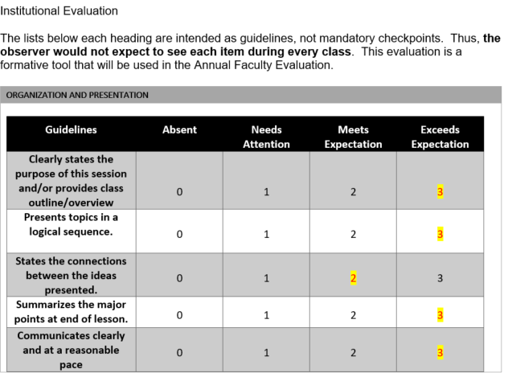
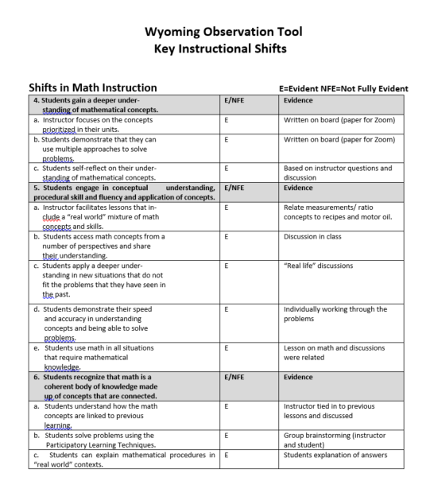
Chapter 12: What evidence?
Staff evaluations are completed annually and SIA observations are utilized by the local program.

Slide 36
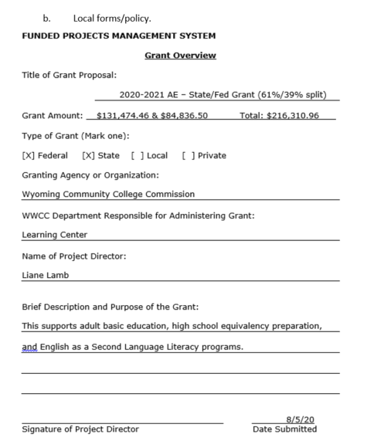
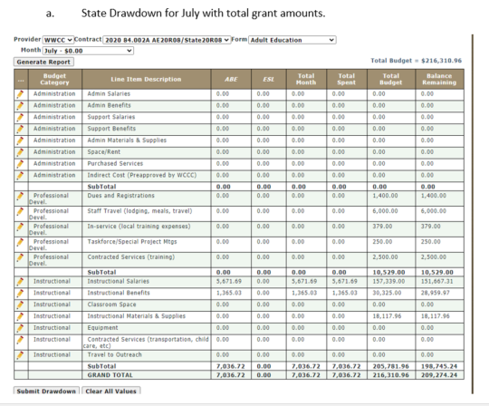
Chapter 13: What evidence?
Program ensures that funds are expended as approved in the final budget

Slide 37
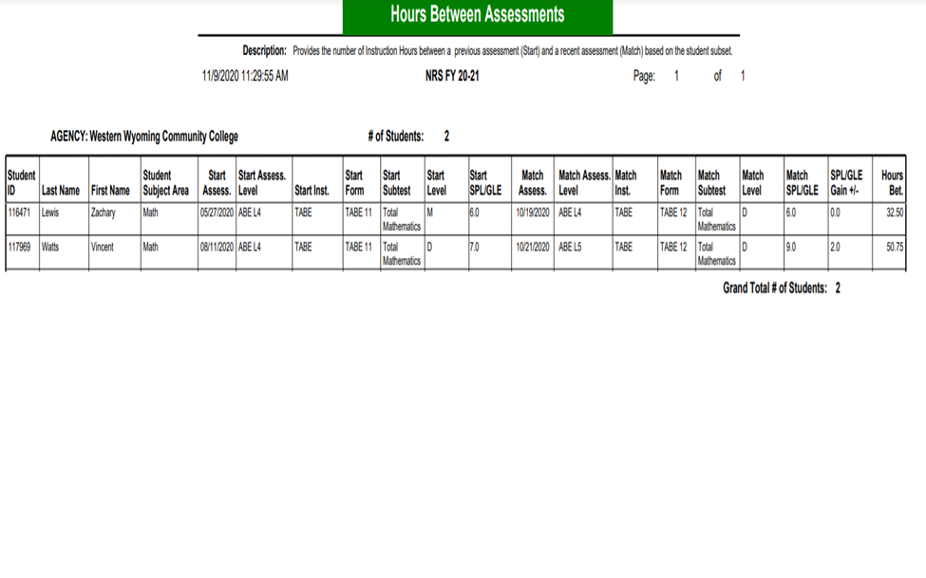
Chapter 14: What evidence?
Report on “Instructional hours since last assessment

Slide 38
Chapter 15: What evidence?
Access to Adult Education through the One-Stop Center is through direct linkage.
DWS has office space in our lab and scheduled days/hours to work with students on-site. DVR will come on-site when there is a student in need of their services. See #3 for more details on access and combined services.

Slide 39
Chapter 16: What evidence?
Examples of how the applicant might satisfy the (GEPA) requirement are clearly stated.
GEPA examples from grant application 20-21 – see #2 above and pictures of T Coil classroom for hearing impaired instructor.
Notes:
Can also reference other areas in the Monitoring checklist.

Slide 40
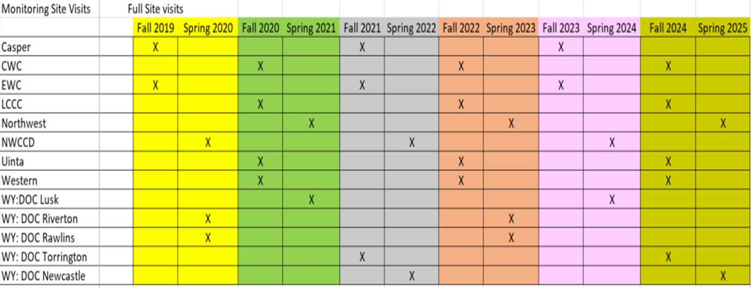
Five Year Monitoring Plan

Slide 41
Special Conditions
Target Monitoring
where there is increased ‘RISK’ in granting/awarding federal funds to a provider.
An applicant/recipient has a history of failure to comply with the general or specific terms & conditions of a federal award.
An applicant/recipient fails to meet expected performance goals as described in Section 200.210.
When an applicant/recipient is not otherwise responsible
Title II Grant and Agreements, Part 200- Uniform Administrative Requirements, Cost Principles, and Audit Requirement for Federal Award, §200.207
Notes:
There are times in which a local program may have to go through what is known as a targeted monitoring process. This can occur under certain circumstances:
where there is increased ‘RISK’ in granting/awarding federal funds to a provider.
An applicant/recipient has a history of failure to comply with the general or specific terms & conditions of a federal award.
An applicant/recipient fails to meet expected performance goals as described in Section 200.210.
When an applicant/recipient is not otherwise responsible

Slide 42
—Jane Goodall
“What you do makes a difference, and you have to decide what kind of difference you want to make.”

