Slide 1
New Director Training
Virtual Format

Slide 2
MODULE
ONE
WIOA:
Federal &
State
State Alignments
to WIOA

Slide 3
The many roles of the AE Local Program Director
AE Program Administrator (Competencies)
Implementing a Performance Accountability System
Promoting Quality Services
Resource Management & Allocation
Program data Monitoring & Evaluation
Professional Development & Dissemination of Best Practices
Developing Partnerships
Expanding Resources & Capacity
One-Stop Participant
Operational Knowledge of WIOA
Notes:
As a new director you will find yourself facing many different and new facets for Adult Education. The purpose of these training modules is to provide the new director with an overview of these responsibilities.

Slide 4
What it is? Why it is important?
Notes:
The Workforce Innovations and Opportunities ACT is a 2014 landmark legislation designed to strength and improve our nation’s public workforce system and help get American’s, including youth and those with significant barriers to employment, into high-quality jobs and careers and help employer shire and retain skilled workers.

Slide 5
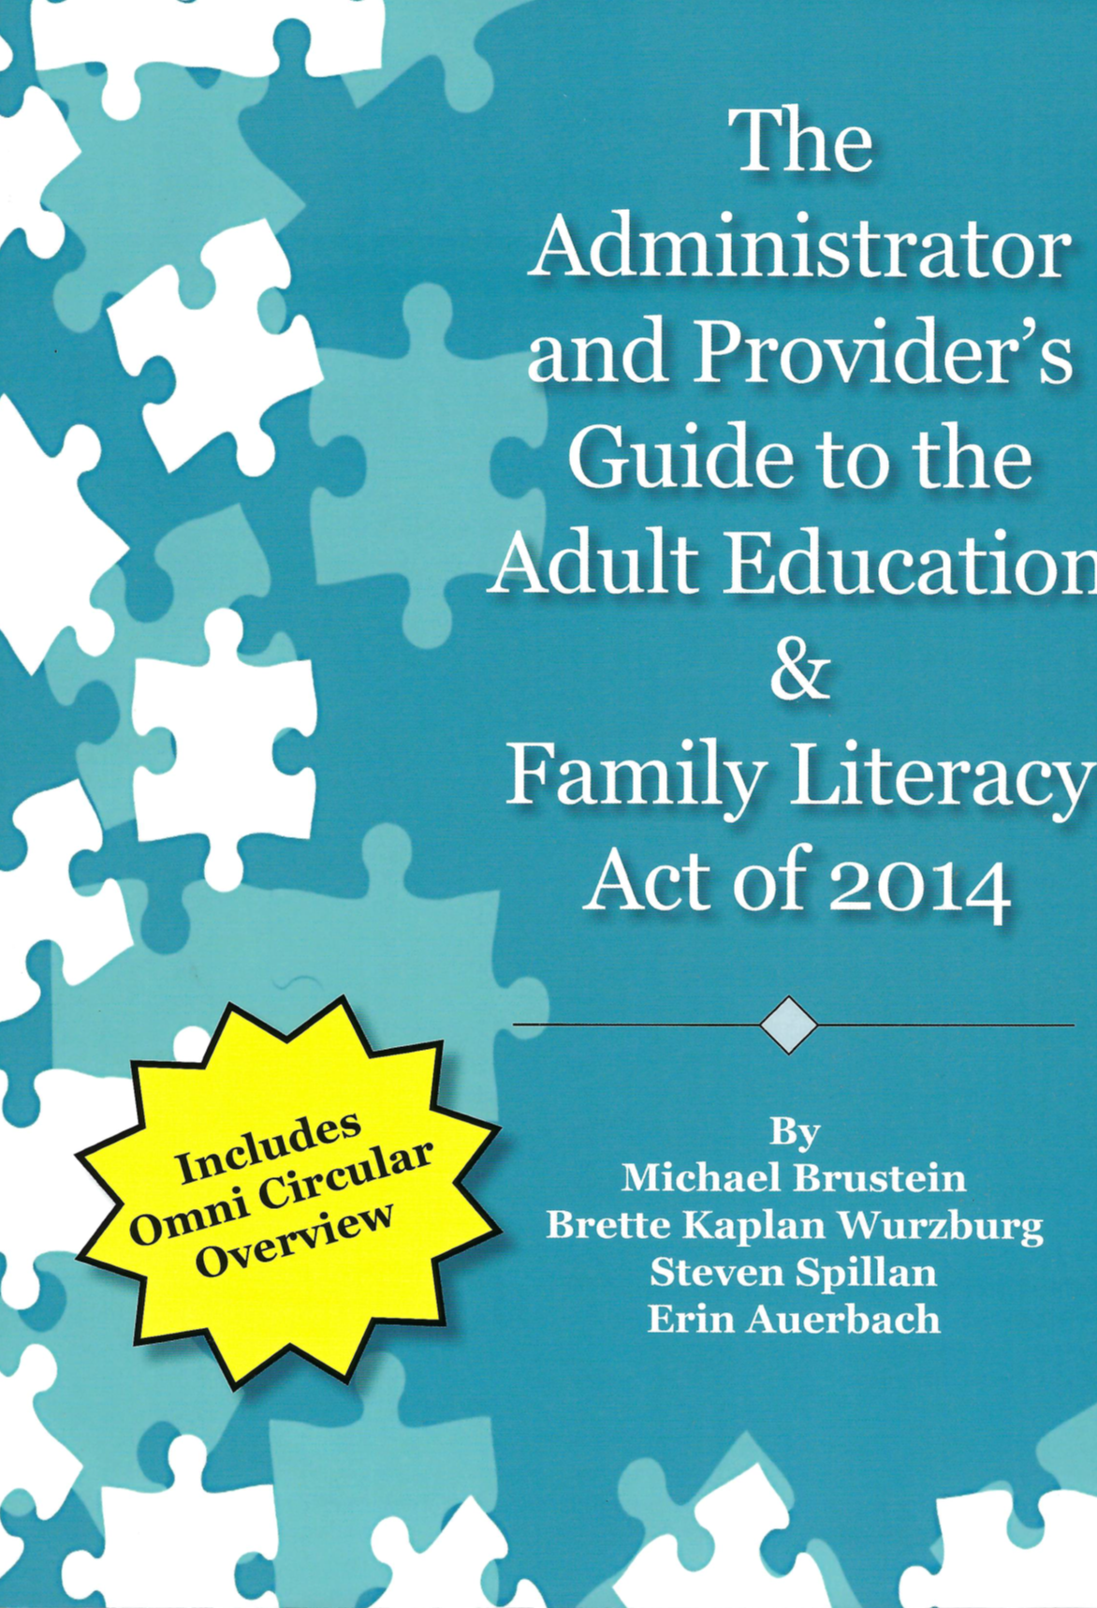
Know the Legislation
Link to Legislation
Notes:
The State has provided each local program with a copy of the ‘Administrator’s & Provider’s Guide to the AEFLA Act of 2014. This guidebook puts WIOA legislation into laymen’s terms for AEFLA programs and is a very useful tool for new director’s to utilize to begin to understand WIOA legislations impact and requirements for Adult Education.
The State recommends that all new directors read this Guide to familiarize oneself with this legislation.

Slide 6
Legislative
Key Concepts
For Adult Education

Slide 7
Core Programs
Title I: B: Adult, Dislocated Workers & Youth
Title II: Adult Education & Literacy
Title III: Wagner-Peyser
Title IV: Voc. Rehabilitation
Required Partners
Notes:
WIOA brings together, in strategic coordination, the core programs of Federal investment in skill
development:
➢ Employment and training services for adults, dislocated workers, and youth and Wagner-Peyser employment
services administered by the Department of Labor (DOL) through formula grants to states; and
➢ Adult Education and literacy programs and
➢ Vocational Rehabilitation state grant programs that assist individuals with disabilities in obtaining employment
administered by the Department of Education.

Slide 8
Purpose
Adult Education
Literacy for employment/economic self-sufficiency
Education and skills needed to help children & lead to improved economic opportunities
IELCE
Prepare & place ESL learners into in-demand industries/occupations
HSEC & transitions to PS/work
ESL
Corrections Education
AEFLA funded programs: Adult Education, IELCE, Corrections Education
Notes:
The purpose of the adult education and literacy funds under AEFLA is to enable eligible providers that receive grants under the program to create local partnerships to provide adult education and literacy activities, including Adult Basic Education (ABE), Adult Secondary Education and English Language Acquisition (ELA), which also includes Corrections Education, in order to:
assist adults to become literate and obtain the knowledge and skills necessary for employment and economic self-sufficiency;
assist adults who are parents or family members to obtain the education and skills that are necessary to becoming full partners in the educational development of their children and lead to sustainable improvements in the economic opportunities for their family;
assist adults in attaining a secondary school diploma education or its equivalent and in the transition to postsecondary education and training, including through career pathways; and
assist immigrants and other individuals who are English language learners in:
o improving their reading, writing, speaking, and comprehension skills in English; and mathematics skills; and
o acquiring an understanding of the American system of Government, individual freedom, and the responsibilities of citizenship; and/or
provide educational programs for criminal offenders in correctional institutions and for other institutionalized individuals who are likely to leave the correctional facility within five years of participation in the program, including academic programs for:
o adult education and literacy activities;
o special education;
o secondary school credit;
o integrated education and training;
o career pathways;
o concurrent enrollment;
o peer tutoring; and
o transition to re-entry initiatives and other post-release services with the goal of reducing recidivism
The purpose of the Integrated English Literacy and Civics Education (IELCE) program is to:
Prepare adults who are English language learners for, and place such adults in, unsubsidized employment in in-demand industries and occupations that lead to economic self-sufficiency; and
integrate with the local workforce development system and its functions to carry out the activities of the program.

Slide 9
The One-Stop System
Career services
Funding the one stop (State Infrastructure Agreement-in kind referrals)
Participate and offer AE services
Identify and eliminate overlapping services
Provide integrated services to enrolled participants
Common intake
Notes:
Further, AEFLA designates grantees as one-stop partners. As one-stop partners, grantees align and contribute to the one stop delivery systems in Local Workforce Development Areas. Specifically, one-stop partners:
➢ Provide access through the one-stop delivery system to such program or activities carried out by the entity, including making the career services that are applicable to the program or activities available at the one-stop centers (in addition to any other appropriate locations);
➢ use a portion of the funds available for the program and activities to maintain the one-stop delivery system,
including payment of the infrastructure costs of one-stop centers; enter into a local memorandum of understanding with the local board, relating to the operation of the one-stop
system; and
➢ participate in the operation of the one-stop system consistent with the terms of the memorandum of
understanding, the requirements of WIOA Title I, and the requirements of the Federal laws authorizing the
program or activities

Slide 10
13 Considerations
The degree to which provider responds to:
a. regional needs as identified in the State Plan
b. serving individuals in need of literacy, including
ESL and low literacy level individuals
The ability of the provider to serve individuals with disabilities
Program past effectiveness
Program alignment to Statewide initiatives & the State plan
For AEFLA Funded programs
Program:
a. is of sufficient intensity & quality
b. utilizes practices based upon rigorous research
c. utilizes effective instructional practices which
embed the Essential components of reading
Instruction in all skill areas is based upon bet practices derived from most rigorous research, including scientifically valid research and effective educational practices.

Slide 11
13 Considerations
Providers effective use of technology & delivery services/distance learning to increase performance
Utilizes learning in context
High quality staff
Providers ability to offer services in conjunction with core partners/other local service providers for the development of a career pathways system
Continued
Flexible scheduling and coordination with local service providers/core partners
Maintains a high quality data system (LACES)
Program ability to provide high quality ESL & civics instruction

Slide 12
AE Allowable Activities
(a) Adult Education means academic instruction and educational services below the post-secondary level that increase an individual’s ability to:
i. read, write, and speak in English and perform mathematics or other activities necessary for the attainment of a secondary school diploma or its recognized equivalent
ii. transition to post-secondary education & training and
iii. obtain employment
Adult Education and Literacy Activities include instruction and education services below a postsecondary level in reading, writing, and speaking in English, and computing and solving problems.
(c) English Language Acquisition includes adult education and literacy activities for English language learners with an additional skill requirement, comprehension of the English language.
(d) Family Literacy Activities include interactive literacy activities between parents or family members and their children.

Slide 13
AE Allowable Activities
Integrated English Literacy and Civics Education will provide immigrants and English learners access to English language acquisition services and civics education and will include workforce training.
Workforce Preparation includes activities, programs, or services designed to help individuals acquire a combination of basic academic skills and employability skills such as critical thinking skills, digital literacy skills, and self-management skills.
Workplace Adult Education and Literacy Activities include instruction at a workplace or an off-site location that is designed to improve the productivity of the workforce.
Integrated Education and Training activities include instruction in basic academic skills and/or English language acquisition skills, workforce preparation activities, and workforce training contextualized for specific occupations or occupational clusters.

Slide 14
Career Services
WY REQUIRED COMPONENTS:
Intake form
Goals sheet
Referrals form
Age waiver (when applicable)
NRS approved assessment
Brain based learning theory
Participatory learning
Mind set
Career explorations (including the provision of workforce/labor information regarding most in-demand industries/jobs for the region)
PowerPath (when applicable)
Introduction to AE Standards
Program specific topics
An Orientation to Adult Education
Multiple components, both federal and state requirements
Policy #03092020
Notes:
The federal and state regulations for career services are defined in policy and can be found on the Commissions website.

Slide 15
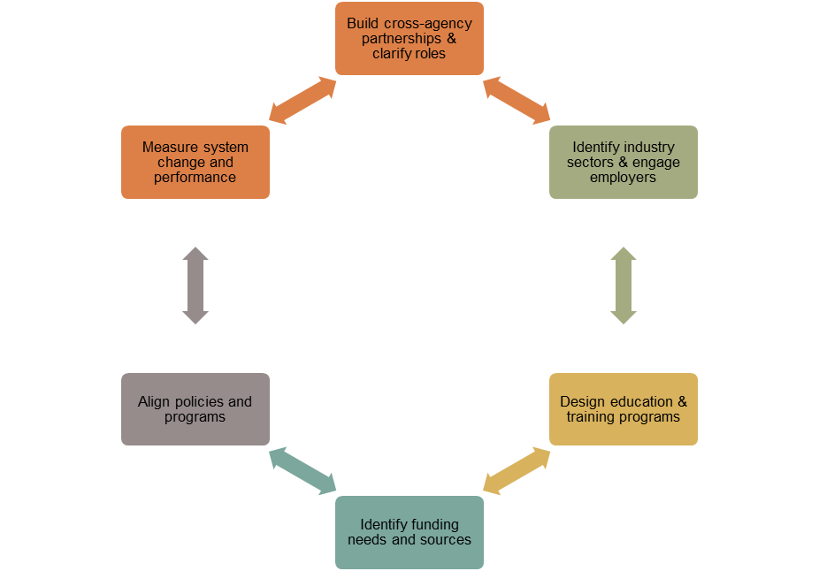
Career Pathways
Notes:
The legislation provides universal access to career services, which are defined and addressed in each of Wyoming’s Adult Education Career Services course.
Career Pathways is an important element of WIOA legislation and of the Unified State Plan. As such, local Adult Education programs are required to develop programming that aligns to a career pathways system. The Career Pathways initiative is a unified planning system that reorients existing education and workforce services to focus on successes in postsecondary/workforce (economic success for the region). The figure shown in the graphic depicts the six core elements to the development of the Career Pathways initiative.

Slide 16
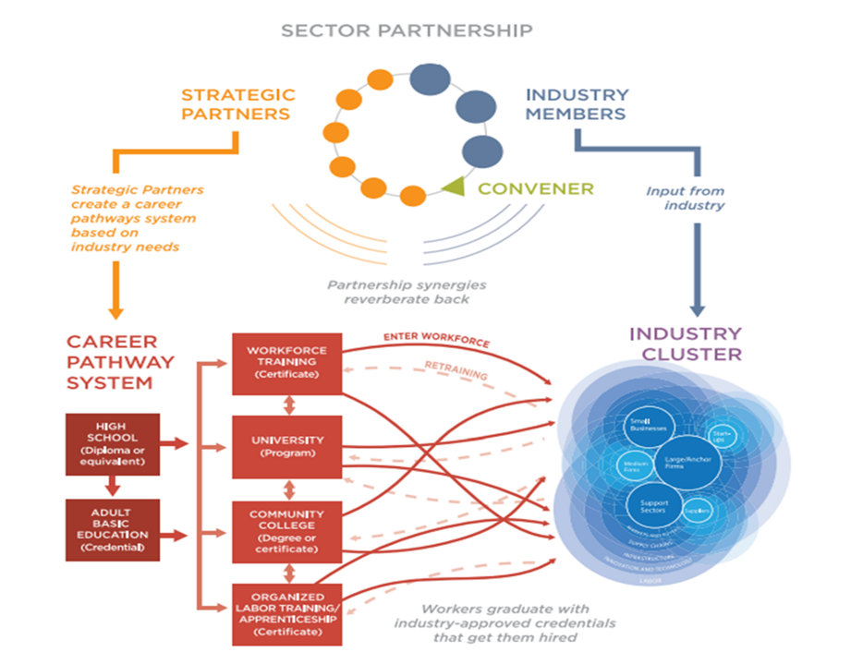
Career Pathways
National Governor’s Association
Notes:
To clarify how a true Career Pathways system should work, the National Governor’s Association developed the graphic below to show the linkages which must occur between sector partnerships and a Career Pathways System. Notice the importance of Adult Education in this graphic!

Slide 17
Leadership: Required
Alignment of AE & literacy activities with other core programs & one-stop partners to implement strategies outlined in the State Plan
Including development of care pathways to provide access to employment/training services
Establish or operate high quality professional development programs to improve adult education instruction including:
Incorporating ECR
Instruction related to specific needs of adult learners
Instruction provided by volunteers/other personnel
Dissemination of information about models/best practices
Provision of technical assistance to include:
Development and dissemination of instructional and programmatic practices based on best available research in reading, writing, speaking, mathematics, English language acquisition, distance education, and staff training
Role of local providers as one-stop partners
Assistance in use of technology
Monitoring & Evaluation
Of quality of and improvements in AE programs
Dissemination of information about models & proven or promising practices within the State

Slide 18
Leadership: Permissible
Lists 12 illustrative activities
Activities of statewide significance
Collaboration to reduce duplication efforts
Notes:
WIOA lists 12 illustrative activities including –
• Resource centers, technology instruction investments, curriculum development, model development, achieving
performance objectives, transition to postsecondary, content standards, and more….
Includes other activities of statewide significance that promote the purposes of the adult education program
Includes leadership efforts to collaborate with partners to avoid/reduce the duplication of services

Slide 19
WIOA: Required Leadership Activities
Alignment to State Plan
Development of Career Pathways
High Quality PD programs to Improve Instruction
Tech. Assistance based on Rigorous Research
Evaluation & Dissemination of Info about Promising State Practices

Slide 20
State Implementation of WIOA

Slide 21
Adult Education in Wyoming

Slide 22
Guiding Documents/ Protocols for AE in Wyoming
Monitoring
AE Grant Application
Statewide Initiatives
Unified State Plan
WIOA
Notes:
These are the critical documents that guide Adult Education programs in Wyoming. New directors should familiarize themselves with each of these documents.

Slide 23
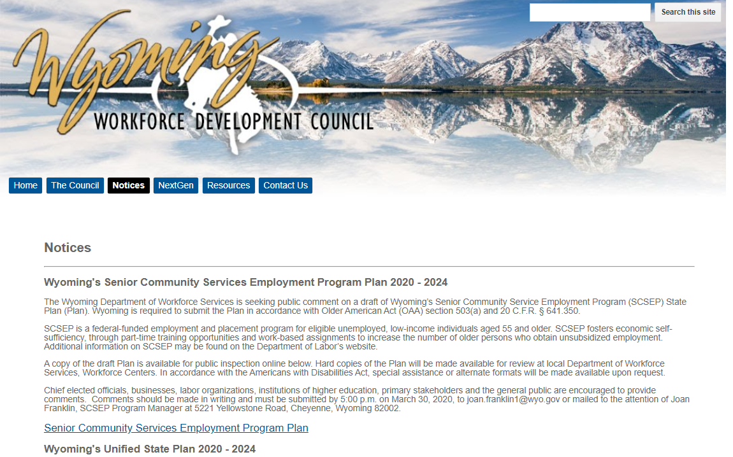
Unified State Plan
Core partners submit a Unified State Plan ‘together’
Multiple tiers of approval are required
https://docs.google.com/a/wyo.gov/viewer?a=v&pid=sites&srcid=d3lvLmdvdnx3eW93ZGN8Z3g6MmE3OWZhNmZjMjJlMzQxNg
Notes:
To show/represent the integration of core partner services AND to meet the regional and economic needs of a state the core partners work together to submit a State Plan. In Wyomng this plan is submitted to the Wyoming Workforce Development Council, the State WIB, first and then to the Governor for approval.
The State Plan is available under the Wyoming workforce Development website or through the link shown on this slide.
Directors are encouraged to read the plan to develop a comprehensive understanding of the roles the WIOA core partners are expected to plan in Wyoming. There are multiple references to Adult Education throughout the plan, but the majority of Adult Education information can be found on pages 31-37; 43-45; 54-55; 66-68, 125-148.

Slide 24
Required Components of the State Plan
Strategic Elements
Economic/Workforce Analysis
State Vision/Goals (Governor)
State Strategies
Operational Planning
Strategy Implementation
Coordination with Combined State Plan Programs
Common Assurances
Title 1
State Operating Systems & Policies
Program-Specific Plan Requirements for Core Programs
Title II
Title III
Title IV

Slide 25
Statewide Inititiatives
DWS Workforce Grant Programs
Information available at: http://wyomingworkforce.org/news/2020-09-21/
Next Generation Sector Partnerships
ENDOW/Educational Attainment Initiative
Perkins V
Notes:
Information regarding ENDOW and the Educational Attainment initiatives can be found on the Commission’s website.
Next Generation Sector Partnerships (Next Gen): the Wyoming Workforce Development Council entered into a partnership to launch Next Generation Sector Partnership projects around the State in an effort to grow critical economic sectors, and to form an alignment amount many education, workforce training, economic development and government partners. Information regarding Next Gen can be found on the Council’s website.
Perkins V: represents an important opportunity to expand opportunities for every student to explore, choose, and follow career and technical education programs of study and career pathways to earn credentials of value. (Federal program). Applicants should suggest/propose strategies on how Adult Education students can concurrently enroll in CTE programs of study. Adult Education programming/activities should clearly demonstrate these strategies for concurrent enrollment. Information regarding Perkins V in Wyoming is available on the Wyoming Department of Education’s website.
Department of Workforce Grant programs
i. Business Training Grant connects employers with professional development opportunities to increase employee skill attainment.
ii. Pre-hire grants focus on creating a trained workforce for a specific Wyoming industry
iii. Pre-obligation grants set aside funds for large relocation or expansion projects for Wyoming businesses
iv. Apprenticeship grants provides funding to develop industry-specific workforce business/industries where there is a shortage of skilled workers
Applicants should suggest concepts and strategies for the development of in-demand industry trainings leading to an industry recognized credential, developed in conjunction with an employer who is a recipient of one of these grants.

Slide 26
AE Grant: Competitive
Demonstrated Effectiveness & the 13 Considerations
General & Program Assurances
Budget Considerations, match funding, indirect costs, waiver for administrative costs
Attachments: PD, Program Intensity & Duration, Program Evaluation, Distance Learning, Anticipated Service Levels, IELCE, IET, etc.
GEPA
Notes:
There are multiple required components to the competitive AE grant RFP, all of which are federal requirements for AEFLA funded grants.
The most recent grant competition was held in March 2020 and was a five year grant. Successful applicants are qualified to re-apply in each subsequent year within the grant cycle.

Slide 27
Demonstrated Effectiveness
P
Pre
Q
Qualification
Pre-qualification
Requires eligible providers to submit two years worth of data showing how well they have served Adult Education students in reading, writing, math, ELA & other subject areas
Employment outcomes
SSD outcomes
Postsecondary/training outcomes
Notes:
Determination of Applicant’s Eligibility
DE is initially reviewed by the State and eligibility is determined. If DE is not successful, the grant application is not read/forwarded to groups of readers.

Slide 28
13 Considerations
Responsive to regional needs AND ability to service individuals withlow literacy and/or ESL
Past effectiveness
#1
#2
#3
#4
Ability to serve individuals with disabilities
Partnerships & aligments to the One-stop system
Notes:
Consideration #1:
(1) the degree to which the eligible provider would be responsive to—
(A) regional needs as identified in the local plan under section 108; and
(B) serving individuals in the community who were identified in such plan as most in need of adult education and literacy activities, including individuals—
(i) who have low levels of literacy skills; or
(ii) who are English language learners;
Consideration #2
the ability of the eligible provider to serve eligible individuals with disabilities, including eligible individuals
with learning disabilities
Consideration #3
past effectiveness of the eligible provider in improving the literacy of eligible individuals, to meet State-adjusted levels of performance for the primary indicators of performance described in section 116, especially with respect to eligible individuals who have low levels of literacy;
Consideration #4
the extent to which the eligible provider demonstrates alignment between proposed activities and services and the strategy and goals of the local plan under section 108, as well as the activities and services of the one-stop partners;

Slide 29
13 Considerations
Sufficient Intensity & duration; use of effective instructional practices and ECR
Use of technology; distance learning
#5
#6
#7
#8
Contextualized instruction; IET’s
Instructional practies for reading, writing, math, and ELA are based on best practices; scientically valid research and effective educational practices
Notes:
Consideration #5:
whether the eligible provider’s program—
(A) is of sufficient intensity and quality, and based on the most rigorous research available so that participants achieve substantial learning gains; and
(B) uses instructional practices that include the essential components of reading instruction;
Consideration #6:
whether the eligible provider’s activities, including whether reading, writing, speaking, mathematics, and
English language acquisition instruction delivered by the eligible provider, are based on the best practices derived from the most rigorous research available and appropriate, including scientifically valid research and effective educational practice
Consideration #7:
whether the eligible provider’s activities effectively use technology, services, and delivery systems, including
distance education in a manner sufficient to increase the amount and quality of learning and how such technology, services, and systems lead to improved performance
Consideration #8:
whether the eligible provider’s activities provide learning in context, including through integrated education and training, so that an individual acquires the skills needed to transition to and complete postsecondary education and training programs, obtain and advance in employment leading to economic self-sufficiency, and to exercise the rights and responsibilities of citizenship;

Slide 30
13 Considerations
Qualified staff; high quality PD
Flexible schedule and effective coordination with community service providers
Regional need for ELA
#9
#10
#11
#12
High quality MIS system
Coodination with other service providers for the development of career pathways
Notes:
Consideration #9:
whether the eligible provider’s activities are delivered by well-trained instructors, counselors, and administrators who meet any minimum qualifications established by the State, where applicable, and who have access to high quality professional development, including through electronic means;
Consideration #10:
whether the eligible provider’s activities coordinate with other available education, training, and social service resources in the community, such as by establishing strong links with elementary schools and secondary schools, postsecondary educational institutions, institutions of higher education, local workforce investment boards, one-stop centers, job training programs, and social service agencies, business, industry, labor organizations, community based organizations, nonprofit organizations, and intermediaries, for the development of career pathways
Consideration #11
whether the eligible provider’s activities offer flexible schedules and coordination with Federal, State, and local support services (such as child care, transportation, mental health services, and career planning) that are necessary to enable individuals, including individuals with disabilities or other special needs, to attend and complete programs
Consideration #12
whether the eligible provider maintains a high-quality information management system that has the capacity to report measurable participant outcomes (consistent with section 116) and to monitor program performance; and
Consideration #13
whether the local areas in which the eligible provider is located have a demonstrated need for additional
English language acquisition programs and civics education programs.

Slide 31
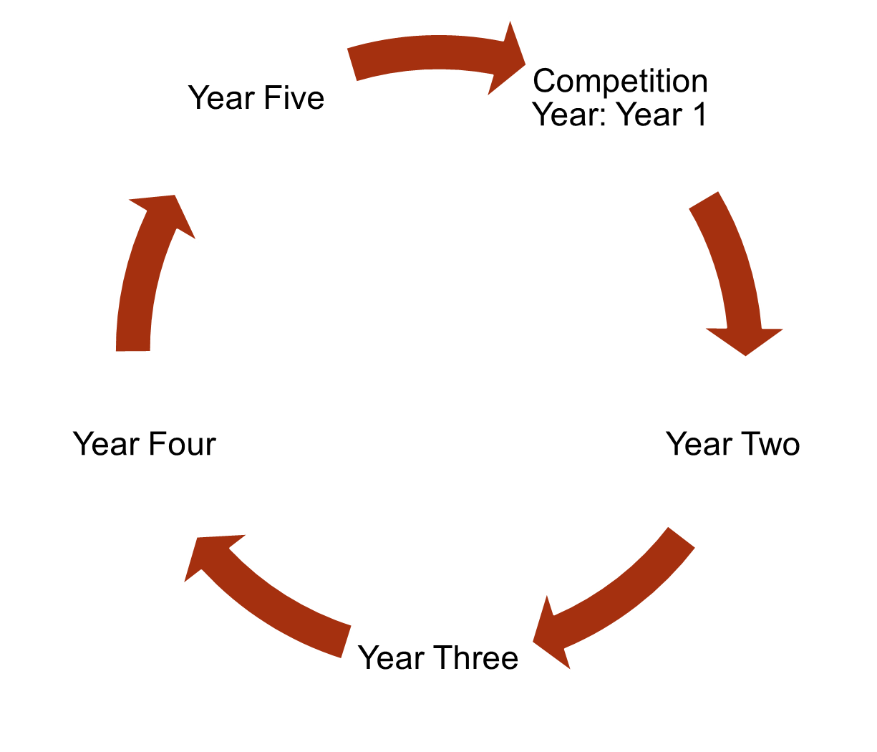
Notes:
An RFP process for AE which utilizes federal funds begins by drafting a document that conforms to both WIOA legislation and OCTAE requirements. OCTAE has given states permission to hold a competition that allowed for a five year grant cycle, which is why Wyoming’s AE grants were extended beyond the typical 3 year process. Before an RFP is released, states were given the option to allow OCTAE to review & approve the document before it was published. In our case, OCTAE did approve the RFP.
The competition selects those providers who are ELIGIBLE to reapply for the next four years. Wyoming’s AE Grant is a five year grant cycle requiring that selected providers resubmit an application in each year of the grant cycle. It does not indicate that selected providers are automatically eligible for funding for each year in the grant cycle without submitting a reapplication. Selected providers may at the end of any year within the cycle decide to opt out of the grant, in which case funding would cease. Or a provider may submit a reapplication for consideration in funding the project.

Slide 32
Re-applications (Non-competitive)
Use of funds
13 Considerations
Program monitoring, evaluations, goals
Changes to original application
Staffing & PD Plans
Budgets
Notes:
In each subsequent year of a grant cycle, approved applicants can reapply for AEFLA grant funds. A typical reapplication process can include: 1) how funds will be used 2) 13 considerations 3) Changes/modifications to be made from the original grant competition 4) Program monitoring/evaluations & goals 5) Staffing & PD 6) budgetary concerns

Slide 33
7) Attachments
1) General Information
6) Budget Documents
2) Cover Page
3) General & Program Assurances
5) A Narrative
4) GEPA Attestation
Notes:
Reapplications are typically due in the Spring of each year.
The State sends out notices to all approved providers that the reapplications are available on the WCCC website.
There are typically seven sections to the reapplication process: general information, a cover page, general & program assurances, a GEPA attestation, a narrative, budgetary documents, and misc. attachments on such things as: goals, anticipated service levels & hours of instruction, PD plans, IET planning tool, confidentiality/non-disclosure agreements, or any other State requested documentation.

Slide 34
SEA
Monitoring
Policies
Funding
State Plan (WIOA)
Statewide Initiatives, including Next Gen
Develop integrated programming, referrals to/from core partners & local service providers
Cross Trainings
One-Stop participation
Utilize career pathways system
Follow general and program assurances
Notes:
Local providers who decide to reapply are required to show, in each year of the grant cycle, how proposed programming will align to the WY State Plan, statewide initiatives as outlined in the RFP, and to develop integrated programming which includes referrals to/from core partners and other local service providers. Providers are also required to cross train core partners so that each core partner is fully aware of what services are being provided. This is to ensure that there are no duplication of services being provided between the core partners. Participation in the One-stop system is not optional. Local programs which utilize federal funds for AE are required to fully participate in the One-stop system in Wyoming. (with limited exceptions for DOC) A career pathways system of education must also be used by AE providers in Wyoming. And providers are required to follow the guidelines outlined on the general and program assurances. These are all on-going processes that must be demonstrated by local AE providers throughout the lifecycle of the AE grant.
In some ways, the State Educational agency, is an extension of OCTAE as it is tasked with monitoring that each of the requirements outlined in the RFP are being implemented and follow NRS/OCTAE guidelines. In order to help local providers know and understand how NRS/OCTAE rules and regulations are to be implemented within a State, the SEA has to create formal written policies and then monitor that these policies are being implemented so that funding can be continued.
Selected providers need to understand that the process of reapplying each year in the grant cycles does not necessarily mean that a provider will be approved for funding in any grant year.

Slide 35
Risk Assessment
State Educational Agency (SEA) required to conduct a risk assessment at the beginning of each program year to evaluate each grantee’s risk for the purpose of determining a monitoring plan.
Notes:
Purpose
Per 2 CFR 200.331(b), the State Educational Agency (SEA) responsible for overseeing federal adult education grants must conduct a risk assessment at the beginning of each program year, using established criteria, to evaluate each grantee’s risk for the purpose of determining a monitoring plan.

Slide 36
OCTAE Uniform Guidance for Reapplications (2 CFR§ 200.331(b)-(h))
An evaluation of risk of noncompliance to federal statutes, regulations, terms & conditions of the initial award determined through a monitoring process and may include such factors as:
Prior experience with the same or similar type of award
Results of previous audits
Whether the grantee has new personnel or new or substantially changed systems
The extent and results of Federal awarding agency monitoring
Special (specific) conditions placed upon a grantee (i.e. determined through a competition process)
Results of SEA monitoring of local providers to ensure that the grantee is using funds for authorized purposes, in compliance with Federal statutes, regulations, & the terms and conditions of the grant; and that performance goals are achieved.
Verify that grantee is audit as required by Subpart F-Audit Requirements
Determine whether grantee monitoring visits have indicated that existing conditions necessitate adjustment.
Implementing enforcement actions against noncompliant grantees as described in §200.338.
Notes:
In addition, reapplications will also need to address OCTAE Uniform Guidance which evaluate the level of risk a grantee has on such factors as those shown on the slide.

Slide 37
Risk Assessment: The Process
Professional Development
Financial Factors
Program Performance
Staff change
Notes:
Process
Once Annual Financial Reports have been submitted, the SEA will create a ‘Risk Assessment’ for grant applicants.
This risk assessment evaluates the risk in awarding funds to a grantee based on the organization’s previous year experiences in: 1) Finance, 2) Staff change, 3) attendance & professional development, 4) Performance

Slide 38
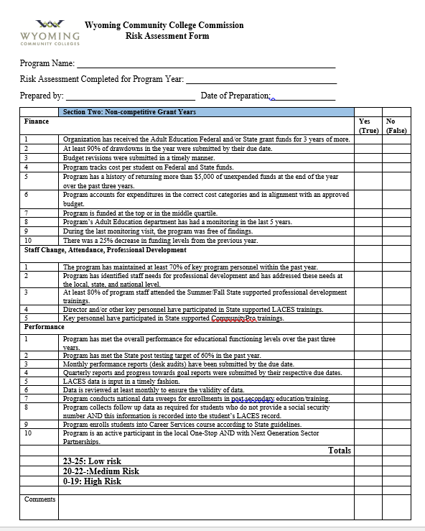
Notes:
This side shows a sample Risk Assessment.

Slide 39
—Oprah Winfrey
“Step out of the history that is holding you back. Step into the new story you are willing to create.”

